Slide 1
Group Presentation-CPIT 498
Names of the Group Members
1. Abdullah Ali Salem 1553463
2. Abdulazez Saleh Shikh 1539694

Slide 2
Abdullah ali salem

Slide 3
Vision
web-based platform in Arabic
So why select this idea ?
We are increasing our business skills.
Good source of money supporting us in software development in our field.
Creating a web-based platform in the Arab community will be a new experience for users so the platform is attract the Arabic users because it does not exist.

Slide 4

Project Title
Daily Experience web-based platform for Arabic users have an idea in all areas.

Slide 5
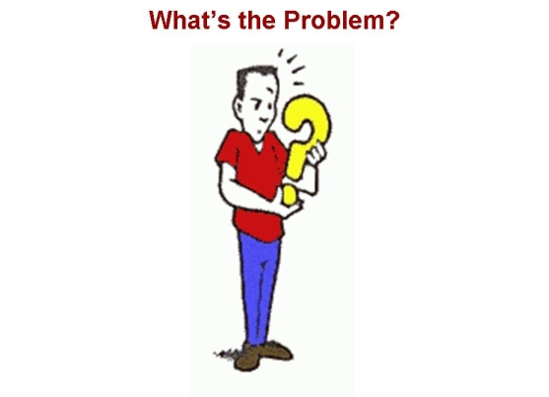

Problem Definition
Language
Searching
Arrangement

Slide 6


Current Situation(Language)
organized web-based platform for Do It Yourself (DIY) instructions does not exist in Arabic.

Slide 7

Current Situation(Searching)
Arabic users use forums, personal blogs, social networks to document instructions on how to do things themselves also to search about anything needs.

Slide 8

Current Situation(Arrangement)
Despite these methods (forums, personal blogs, social networks) provide good content to the Internet users, they need to be organized, categorized and collected in one place.

Slide 9
Abdulazez Saleh shaikh

Slide 10
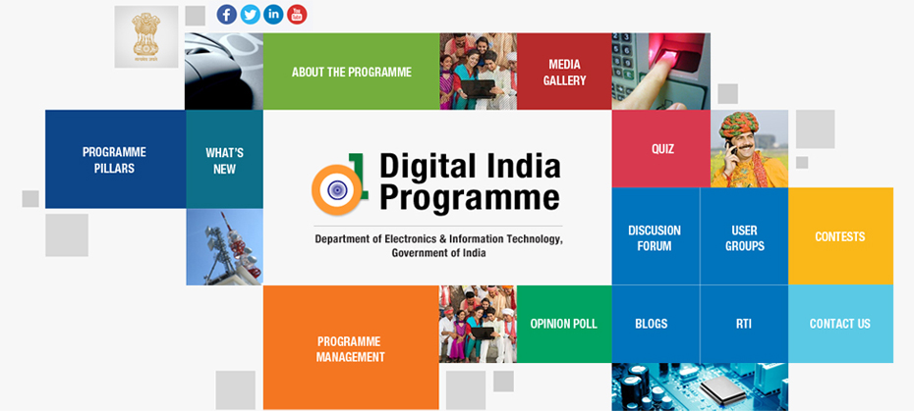
Our Suggested Solutions
Creating a web-based platform that brings together the Arabic content creators of DIY instructions and Internet users.

Slide 11
Aims
organize the related DIY Arabic content on the Internet.
bring together content creators and users at one place.
Create our own business
Create an attractive user environment

Slide 12


Knowledge Area?
HTML Markup
CSS
JavaScript
PHP language
Software Engineering
MySql
E-commerce

Slide 13

What the committee will see at the end of our Project
A platform that supports Arab community.
An environment that combines content creator and user.
Continue to develop the platform after the end of the course

